Slide 1
Computer Graphics (L10) EG678EX
2-D Viewing

Slide 2
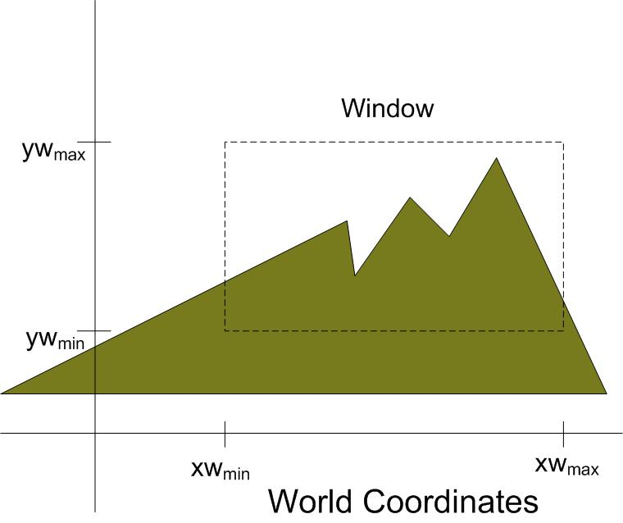
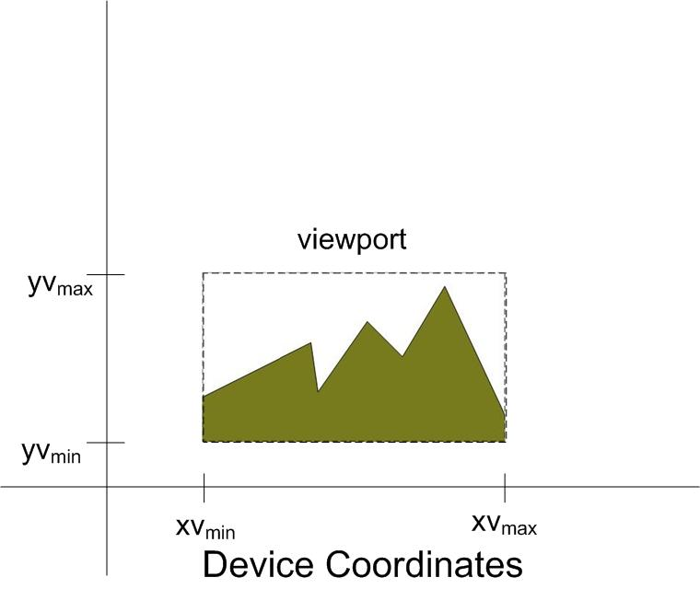
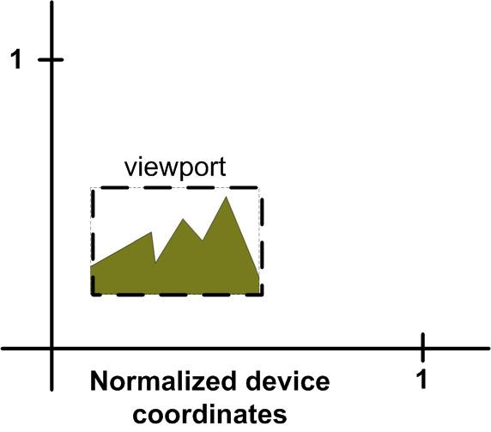
Viewing Transformation
Transformation from world to viewport
For Fixed sized viewport, zooming in effect is attained if window size is decreased and zooming out effect if window size is increased.
Panning effect is attained by successively changing the position of viewing window
The normalized device coordinates maps the world co-ordinate to the viewport of maximum size = unit square as shown in figure. The advantage is the mapping is display device independent

Slide 3
2-D Viewing pipeline
Procedures for displaying views of a two-dimensional picture on an output device:
Specify which parts of the object to display (clipping window, or world window, or viewing window)
Where on the screen to display these parts (viewport).
Clipping window is the selected section of a scene that is displayed on a display window.
Viewport is the window where the object is viewed on the output device.
Map viewing coordinates to normalized viewing coordinates using window-viewport specifications
Map Normalized Viewport to Device Coordinates
Construct world coordinate scene using modeling-coordinate transformations
MC
WC
Convert world coordinates to viewing coordinates
VC
NVC
DC

Slide 4
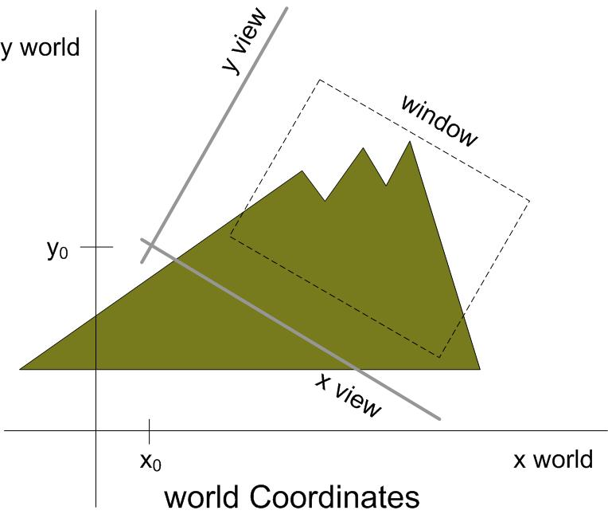
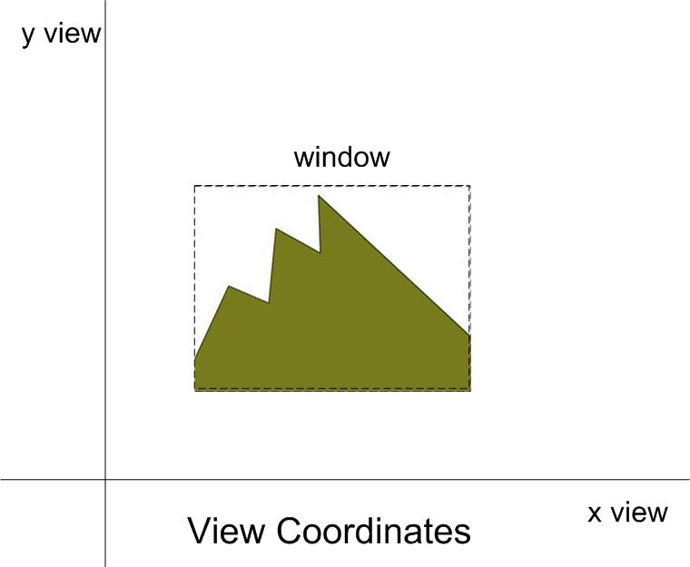
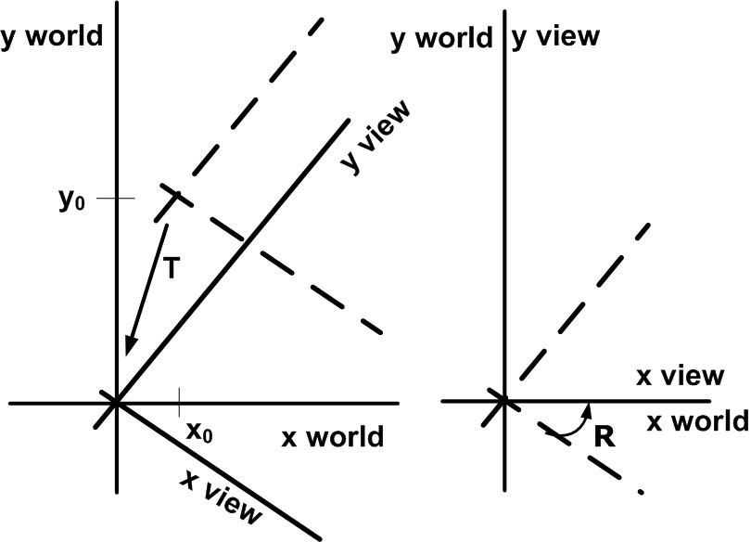
Viewing Reference Frame
Setting up viewing Reference Frame
The matrix is obtained in two steps:
Translate Viewing reference frame origin to world origin
Rotate Viewing reference frame to coincide with world coordinate axes
Thus we get the matrix as
M_{wc,vc} = R.T

Slide 5
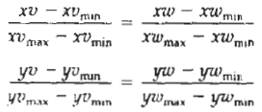
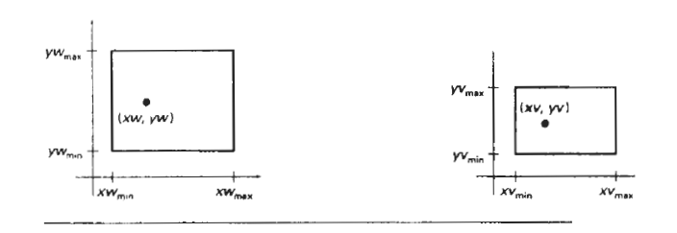

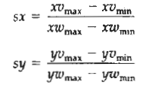
Windows To Viewport Co-ordinate Transformation
Solving these we get
Where scaling factors are
If sx = sy, the proportion is maintained otherwise the scene is stretched

Slide 6
Point Clipping
xw_{min} ≤ x ≤ xw_{max}
yw_{min} ≤ y ≤ yw_{max}
yw_{max}
If all the four inequalities are satisfied for a point with co-ordinate (x,y), the point is accepted; i.e not clipped
yw_{min}
xw_{min}
xw_{max}

Slide 7
Line Clipping
[Note: most of the slides about line clipping are from some internet resource]

Slide 8
Line Clipping
(xw_{min}, yw_{max})
Clipping window
(xw_{min}, yw_{max})
Clipping window
(xw_{max}, yw_{max})
(xw_{max}, yw_{max})
(xw_{min}, yw_{min})
(xw_{max}, yw_{min})
(xw_{min}, yw_{min})
(xw_{max}, yw_{min})
Before clipping
After clipping
What are the methods (algorithms) to perform clipping operations ?

Slide 9
1. Cohen-Sutherland line clipping
Top-Left
Top
Top-Right
1001
1000
1010
Left
Inside
Right
0001
0000
0010
Bottom-Left
Bottom
Bottom-Right
0101
0100
0110
LRBT
Region codes
T B R L
Bit position 1 2 3 4
Basic Idea
label the Left, Right, Bottom and Top of clipping rectangle with region codes
Test for Trivial Acceptance and Rejection (How?)
If not trivially accepted or rejected successively clip out the portion of line outside the clip boundary and test whether it is trivially accepted or rejected

Slide 10
Cohen-Sutherland line clipping
Region coding
How would you decide which region an endpoint is in?
e.g
if (x<xw_{min}) && (y>y_{max}) 🡪 the point is at the Top-Left
Are there cases we can trivially accept or reject?
How would you test for those?
A1=0000,A2=0000
both (0000) 🡪 accept trivially
B1=1001,B2=1010
both NOT (0000)
AND Operation
B1 🡪 1001
B2 🡪 1010
Result 1000
Result = NOT (0000) 🡪 reject trivially
1001
B1
1000
1010
D1
B2
C1
A2
0001
0000
0010
A1
C2
0101
0100
0110
D2

Slide 11
Cohen-Sutherland line clipping
Algorithm Steps:
Assign a region code for each endpoints.
If both endpoints have a region code 0000 ---🡪 trivially accept these line.
Else, perform the logical AND operation for both region codes.
3.1 if the result is NOT 0000 🡪 trivially reject the line.
3.2 else (i.e. result = 0000, need clipping)
3.2.1. Choose an endpoint of the line that is outside the window.
3.2.2. Find the intersection point at the window boundary (base on
region code).
3.2.3. Replace endpoint with the intersection point and update the
region code.
3.2.4. Repeat step 2 until we find a clipped line either trivially accepted
or trivially rejected.
Repeat step 1 for other lines.

Slide 12
Cohen-Sutherland line clipping
Intersection calculations:
Intersection with vertical boundary
y = y₁ + m(x-x₁)
Where
x = xw_{min} or xw_{max}
Intersection with horizontal boundary
x = x₁ + (y-y₁)/m
Where
y = yw_{min} or yw_{max}

Slide 13
Cohen-Sutherland line clipping
Example:
P1 = (0,120)
(150,100)
1. P1=1001, P2=0100
2. (both 0000) – No
3. AND Operation
P1 🡪 1001
P2 🡪 0100
Result 0000
3.1 (not 0000) – no
3.2 (0000) yes
3.2.1 choose P2
3.2.2 intersection with BOTTOM boundary
m = (5-120)/(130-0) = -0.8846
x = x1 + (y –y1)/m where y = 10;
x = 130 + (10-5)/ -0.8846 = 124.35 = 124
P2’ = (124, 10)
3.2.3 update region code P2’ = 0000
3.2. 4 repeat step 2
(10,10)
P2 = (130,5)

Slide 14
2. Liang-Barsky Line Clipping
Based on parametric equation of a line:
x = x₁ + u.△x
y = y₁ + u.△y
Similarly, by adopting expressions for point clipping, the clipping window is represented by:
xw_{min} ≤ x₁ + u.△x ≤ xw_{max}
yw_{min} ≤ y₁ + u.△y ≤ yw_{max}
… or,
u. p_{k} ≤ q_{k} k = 1, 2, 3, 4
where:
0 ≤ u ≤ 1
(x₁,y₁)
k = 1 ( is the line inside left boundary ?) p₁ = - △x , q₁ = x₁ – xw_{min}
k = 2 (is the line inside right boundary ?) p₂ = △x , q₂ = xw_{max}- x₁
k = 3 (is the line inside bottom boundary ?) p₃ = - △y , q₃ = y₁ – yw_{min}
k = 4 (is the line inside top boundary ?) p₄ = △y , q₄ = yw_{max} - y₁
(x₂,y₂)
P_{k}<0 infinite extension of the line proceeds from outside to inside the infinitely extended boundary
P_{k}>0 infinite extension of the line proceeds from inside to outside of the infinitely extended boundary

Slide 15
Liang-Barsky Line Clipping
Trivial rejection
Reject line with p_{k} = 0 for some k and one q_{k} < 0 for these k.
For line with p_{k} = 0 for some k and all q_{k} ≥ 0 for these k
Line is parallel to one of clip boundary
Some portion of line is inside
For intersection with boundaries the
parameters are supposed to be r_{k} given by
Clipped line will be:
x₁’ = x₁ + u₁. △x; u₁ ≥ 0
y₁’ = y₁ + u₁. △y;
x₂’ = x₁ + u₂. △x; u₂ ≤ 1
y₂’ = y₁ + u₂. △y;
(x₁,y₁)
r₁
(x’₁,y’₁)
r₄₌u₁
(x’₂,y’₂)
r₂=u₂
u₂
u₁
r₃
(x₂,y₂)
r_{k} = q_{k}/p_{k}
u₁ (For intersection with the boundaries to which line enters the boundary) = maximum value between 0 and r (for p_{k} < 0),
u₂ (For intersection with the boundaries to which line leaves the boundary) = minimum value between r and 1 (for p_{k} > 0),

Slide 16
Liang-Barsky Algorithm Steps
If p_{k} = 0 for some k then the line is parallel to a clipping boundary. Now test q_{k} :
if one q_{k} < 0 for these k then line is outside
if all q_{k}≥0 for these k then some portion of line is inside
For all p_{k} < 0 (i.e. line proceeds from outside to inside the boundary) calculate u = max (0, {r_{k} : r_{k}=q_{k} /p_{k} }) to determine intersection point with the possibly extended clipping boundary k and obtain a new starting point for the line at u₁.
For all p_{k} > 0 (i.e. line proceeds from inside to outside the boundary) calculate u₂ = min (1, {r_{k} : r_{k}=q_{k}/p_{k}}) to determine intersection point with extended clipping boundary k and obtain a new end point at u₂.
If u₁ > u₂ then discard the line
The line is now between [u₁,u₂]

Slide 17
Liang-Barsky Algorithm Steps
Example:
k
p_{k}
q_{k}
r_{k}
1
-△x
= -(110-10)
= -100
i.e p_{k}<0
x₁ – xw_{min}
= 10-0 = 10
r₁=10/(-100)
=-1/10
(100,50)
u₁
P2 = (110,40)
2
△x
=110-10=100
i.e p_{k}>0
xw_{max}- x₁
= 100 – 10 = 90
r₂=90/100
=9/10
P1 = (10,10)
u₂
(0,0)
3
-△y
= -(40-10)
=-30
i.e p_{k}<0
y₁ – yw_{min}
= 10–0 = 10
r₃=10/(-30)
=-1/3
We take
u₁ = 0
And
u₂ = 0.9
u₁
4
△y
= 40-10=30
i.e p_{k}>0
yw_{max} - y₁
= 50 – 10 = 40
r₄=40/30
=4/3
u₂

Slide 18
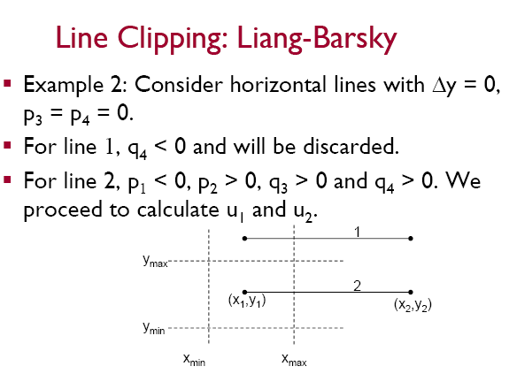

Slide 19
